Slide 1
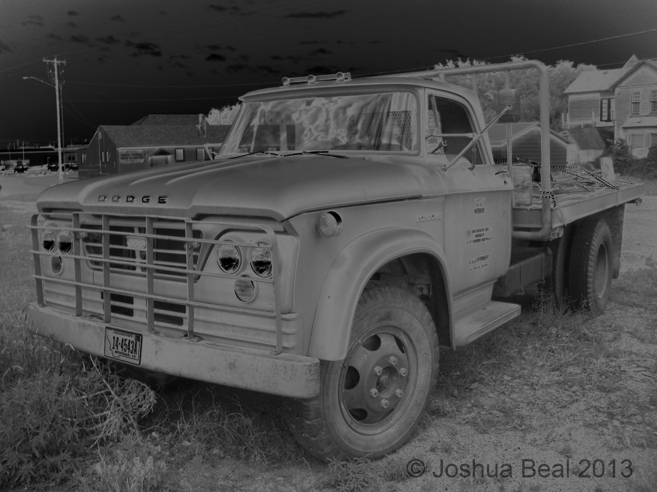
Solarization
By Joshua Beal
May 3, 2014

Slide 2
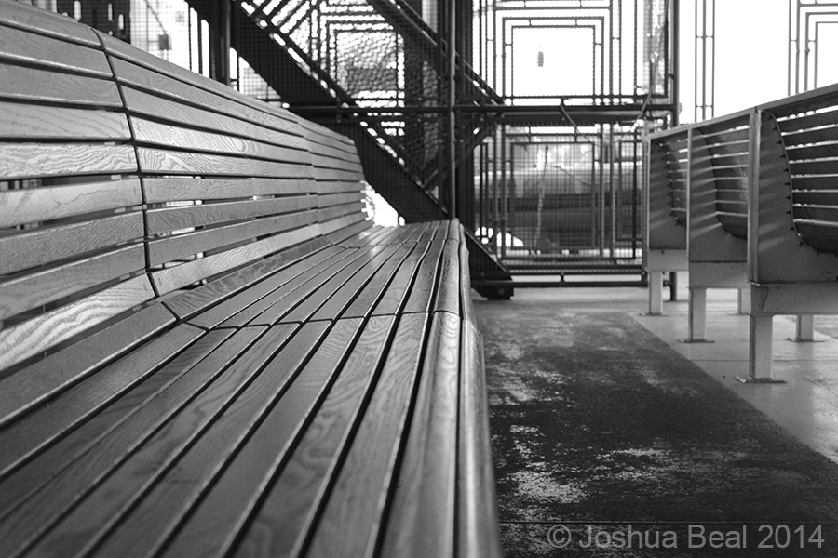
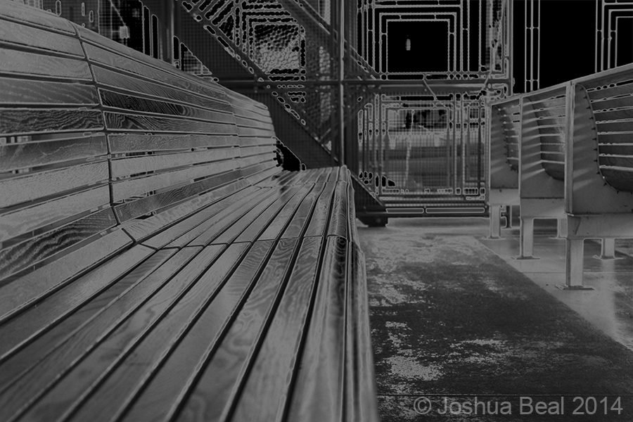
Ferry Bench (Original), By Joshua Beal
Ferry Bench (Solarized), By Joshua Beal
UNDERSTANDING SOLARIZATION
When white light is partially exposed upon a negative through development, a portion of tonal values are reversed. Light areas can turn dark and dark areas can turn light, although not all areas of an image are guaranteed to reverse. The results are unpredictable, so instructions are based upon principle rather than specified steps. In the image above and to the right, the solarization filter was utilized in Photoshop. The background of the bench (representing the skyline and incoming light) has changed from a gray tone to black. Highlights on the bench have also been reversed.

Slide 3
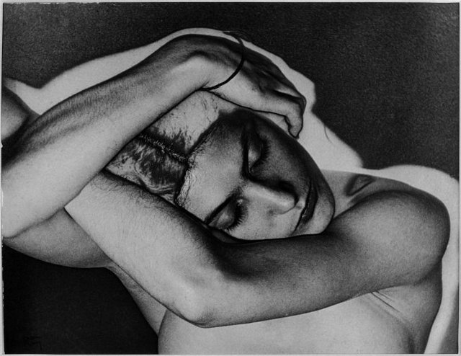
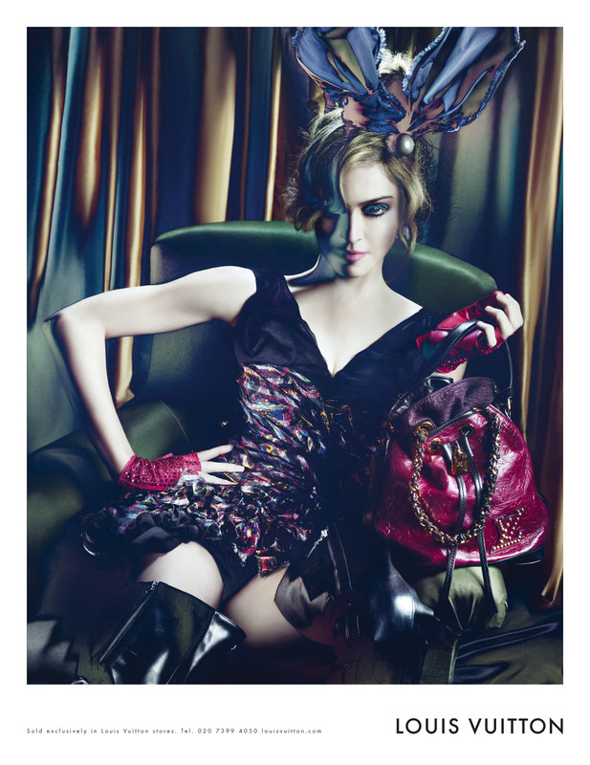
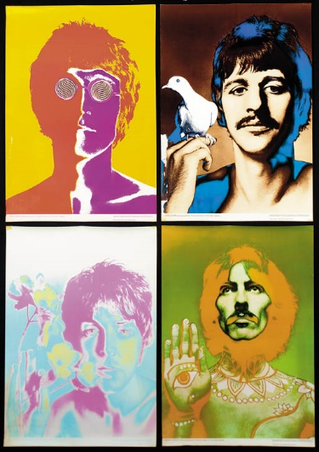
Sleeping Woman, 1929
By Ray Man
Madonna for Louis Vuitton, 2009
By Steven Meisel
The Beatles, 1967
By Richard Avedon
EXAMPLES
Solarization is a less commonly utilized form of image enhancement, but it is not without application. Above are famous examples of this technique.

Slide 4
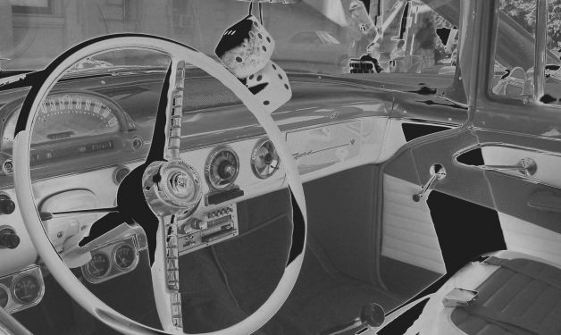
Ford Dashboard # 3, By Lee Paine
BACKGROUND: PART 1
The origins of the development of solarization have been somewhat debated. The earliest mention was in 1857 by William Jackson of Lancaster England, who submitted an essay to the Journal of The Photographic Society of London on the subject of reversing daylight to fall on negatives in order to achieve direct positives. At the time, little was understood about photography as a whole in order to envision the possibilities this technique could foster as an artistic medium and for commercial applications.

Slide 5
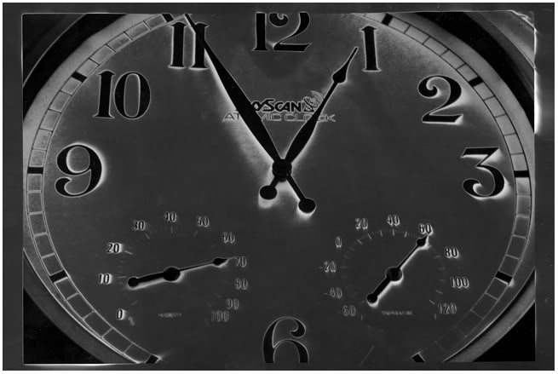
Untitled, Photographer Unknown
BACKGROUND: Part 2
Solarization was first published for the public in 1859 by H. de la Blanchere in L’Art du Photographe. It had a few additional mentions in 1860 by different authors and publications, but did not gain widespread attention until French scientist, Dr. Armand Sabatier wrote on solarization for Cosmos in 1860. Sabatier has since been credited as the founder of solarization and his name has become branded for the technique.

Slide 6
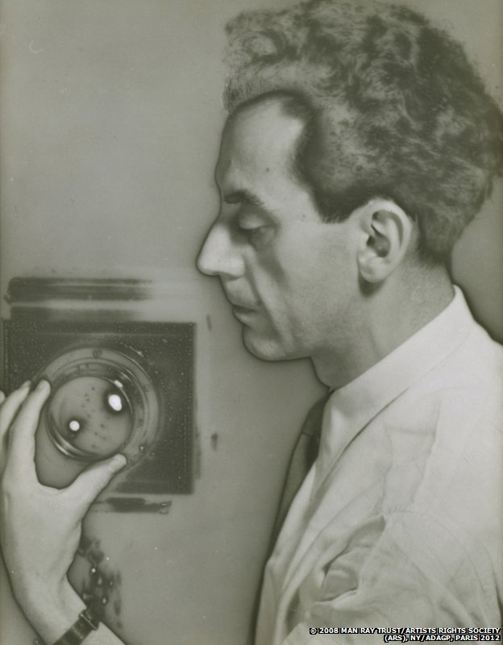
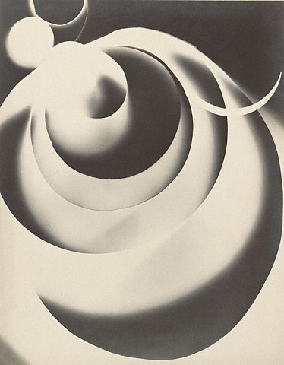
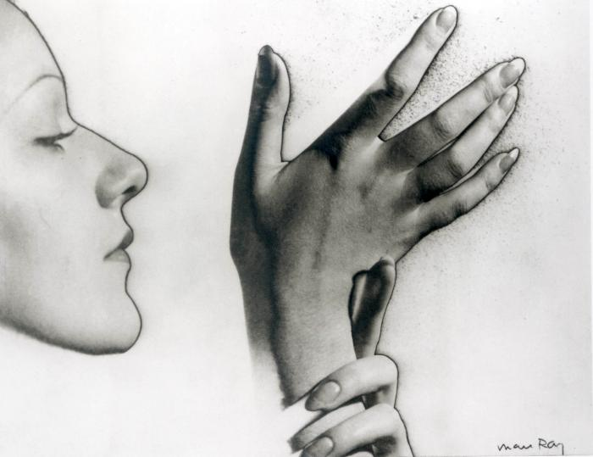
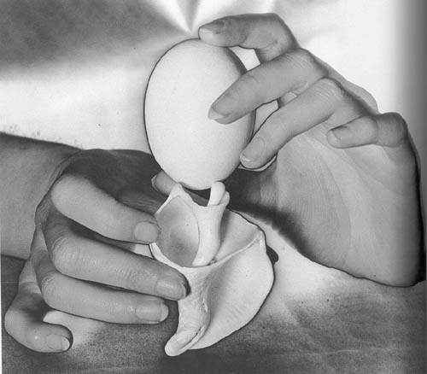
Champs
delicieux, 1922,
By Man Ray
Untitled, 1932,
By Man Ray
L’oeuf et le coquillage, 1931,
By Man Ray
Self Portrait, 1932,
By Man Ray
BACKGROUND: PART 3 (STYLISTIC PIONEERING)
Man Ray (originally named Emmanul Radnitsky) is credited for the greatest production of solarized style. Ray started out as a painter and used his camera to document his work. He later took inspiration from Alfred Stieglitz on making a career of photography. After separating from his wife, he moved from New York to Paris and enjoyed a career in photography for magazines from 1921 to 1940. However, his most well known work was generated outside of these publications for artistic purposes rather than advertisements.

Slide 7
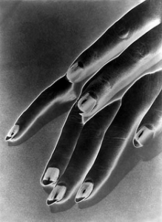
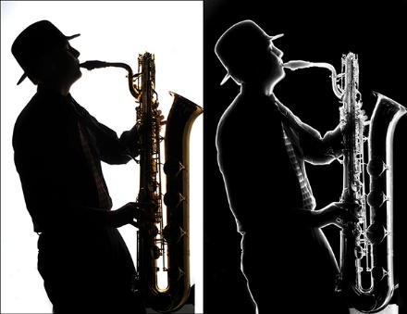
SABATIER EFFECT
What has become known as the “Sabatier Effect” is an extension of solarization. It is essential to cover this subject in conjunction with solarization due to the misinterpretation that the two are synonymous. The Sabatier Effect is a glowing result, or “low density band”, that forms at the edges between highlighted and shadowed areas. Images provided below are strong examples of this effect. Little to no gradation exists in each image, giving attention to the glow.
Study of hands, 1930
By Ray Man
Untitled, Photographer Unknown

Slide 8
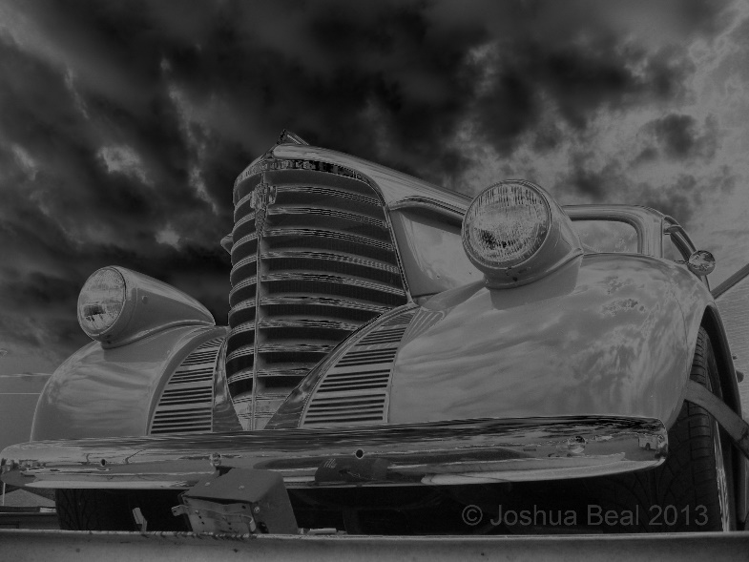
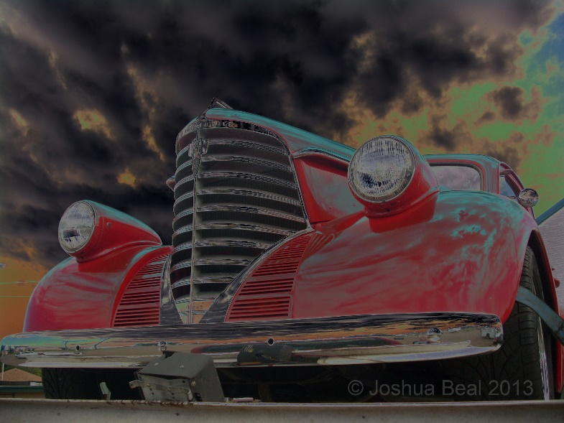
Classic Red (Original), By Joshua Beal
Classic Red (B&W, Solarized), By Joshua Beal
Classic Red (Color, Solarized), By Joshua Beal
IDEAL IMAGES FOR INTENDED SOLARIZATION
Photographs in black and white with sharp outlines and clear shapes are ideal. Color images can work as well, but hues should be bold and clear.

Slide 9
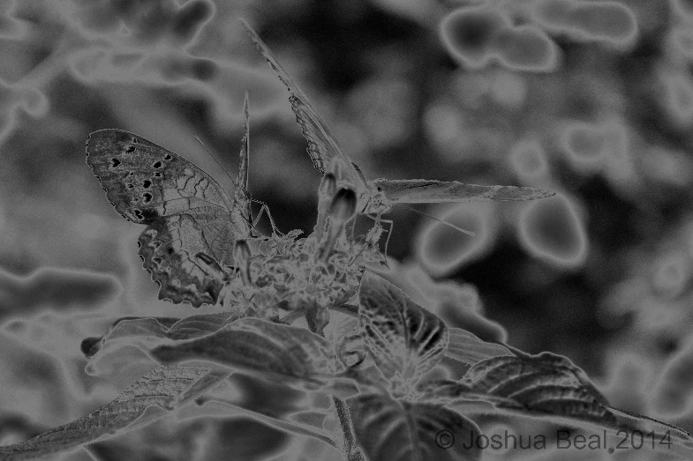
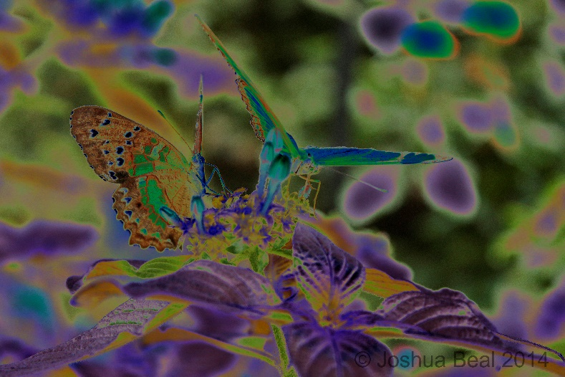
Butterflies (Original), By Joshua Beal
Butterflies (B&W, Solarized), By Joshua Beal
Butterflies (Color, Solarized), By Joshua Beal
UNCOOPERATIVE IMAGES FOR SOLARIZATION
Photographs that may seem sharp or vivid in normal tones may have unintended results when applying solarization. Images that are overloaded with gradation, colors, or layered elements (such as the leaves above) will likely cause the solarized translation to become noisy and undistinguishable.

Slide 10
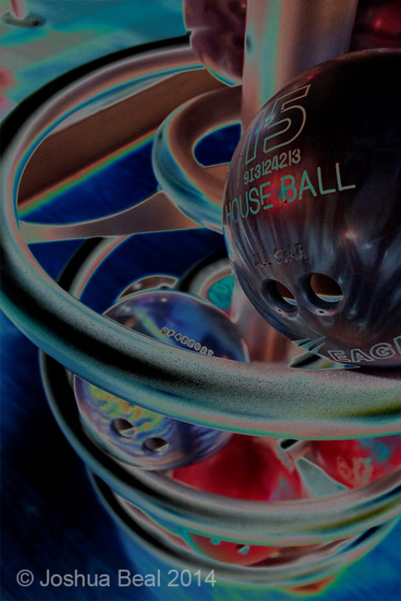
THE END
SUMMARY
Solarization is an artistic technique applied to photography that reverses tones. The Sabatier Effect is an extension of solarization that causes a glowing band in the edges of high contrast between dark and light tones. Dr. Armand Sabatier is given credit for making solarization known as a technique and Man Ray is known for pioneering it as a style in photography. When working with solarization, choose images that are either black and white, or have few colors that are bold and clear.
Bowling Rack (B&W)
By Joshua Beal
Bowling Rack (Color)
By Joshua Beal

Slide 11
Works Cited
Buffaloe, Ed. Controlling the Sabatier Effect. Unbinking Eye. http://unblinkingeye.com/Articles/Solarization/solarization.html
Guver, Jeff. The Sabattier Effect. Digital Photography School. http://digital-photography-school.com/the-sabattier-effect/
Ilford. The Sabatier Effect. http://www.ilfordphoto.com/aboutus/page.asp?n=154
Rags to Revelrie. Solar Psychadelia. http://ragstoreverie.blogspot.com/2010/01/solar-psychadelia.html
Page, Anna. Solarisation, Digitally & In the Dark Room. http://annapagesphotography.blogspot.com/2012/09/solarisation-in-adobe-photoshop.html
Garconnier. Tag Archives: Ray Man. Jan. 4, 2013. http://alagarconniere.wordpress.com/tag/man-ray/
Greenwichtime.com. 2014. http://www.greenwichtime.com/opinion/article/Contrasting-views-Reflecting-on-solarization-4276130.php
Whitney High School Photography. Sabatier Effect Revisited. Jan. 4, 2013. http://www.labrotphoto.com/blog/?p=33
Van-de-Veld, Zoe. How Man Ray Revolutionized Photography. Bright Hub. Aug. 14, 2011. http://www.brighthub.com/multimedia/photography/articles/123179.aspx

